Slide 1


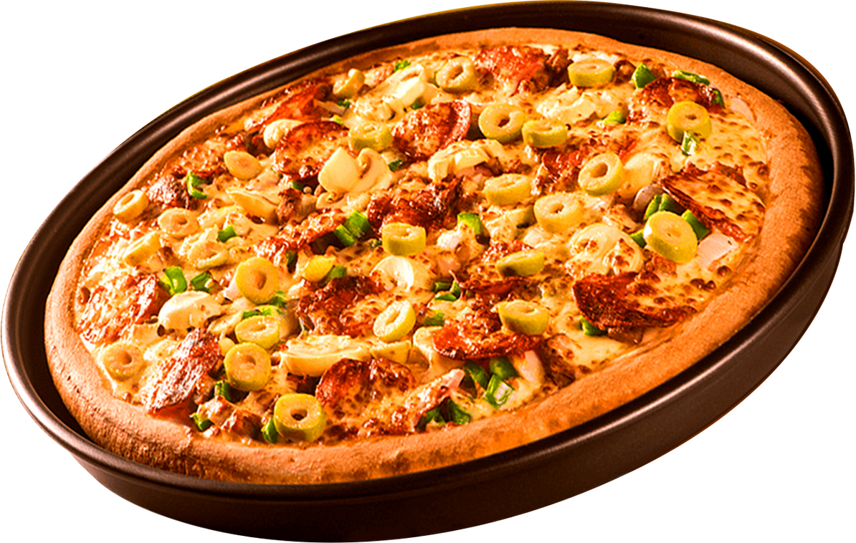


SQL
Project
PIZZA
HUT
WHERE EVERY SLICE TELLS A STORY

Slide 2


SQL
Home
Project
ABOUT PROJECT
📌 OVERALL SUMMARY
The project is a Pizza Hut sales analysis using SQL.
It progresses from simple counts and totals → grouping & joins → advanced revenue insights.
Business insights you’d get from this:
How many orders and total revenue.
Best-selling pizza sizes and types.
Which hours are busiest.
Which categories perform best.
Revenue contribution by product (good for pricing/marketing).
Long-term growth trend via cumulative revenue.

Slide 3
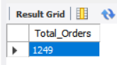
SQL
Project
RETRIEVE THE TOTAL NUMBER OF ORDERS PLACED
QUERY :
RESULT :
SELECT
COUNT(Order_id) AS Total_Orders
FROM
orders;

Slide 4
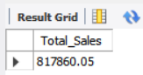
SQL
Project
2. CALCULATE THE TOTAL REVENUE GENERATED FROM PIZZA SALES
QUERY :
RESULT :
SELECT
ROUND(SUM(pizzas.price * order_details.quantity),
2) AS Total_Sales
FROM
pizzas
JOIN
order_details ON order_details.pizza_id = pizzas.pizza_id;

Slide 5
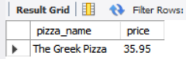
SQL
Project
3. IDENTIFY THE HIGHEST-PRICED PIZZA
QUERY :
RESULT :
SELECT
pizza_types.pizza_name, pizzas.price
FROM
pizzas
JOIN
pizza_types ON pizza_types.pizza_type_id = pizzas.pizza_type_id
ORDER BY pizzas.price DESC
LIMIT 1;

Slide 6
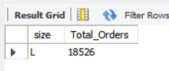
SQL
Project
4. IDENTIFY THE MOST COMMON PIZZA SIZE ORDERED
QUERY :
RESULT :
SELECT
pizzas.size, COUNT(order_details.order_id) AS Total_Orders
FROM
pizzas
JOIN
order_details ON pizzas.pizza_id = order_details.pizza_id
GROUP BY pizzas.size
ORDER BY Total_Orders DESC
LIMIT 1;

Slide 7
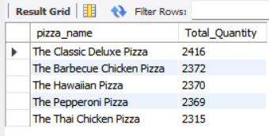
SQL
Project
5. LIST THE TOP 5 MOST ORDERED PIZZA TYPES ALONG WITH THEIR QUANTITIES
QUERY :
RESULT :
SELECT
pizza_types.pizza_name,
COUNT(order_details.quantity) AS Total_Quantity
FROM
pizza_types
JOIN
pizzas ON pizzas.pizza_type_id = pizza_types.pizza_type_id
JOIN
order_details ON pizzas.pizza_id = order_details.pizza_id
GROUP BY pizza_types.pizza_name
ORDER BY Total_Quantity DESC
LIMIT 5;

Slide 8
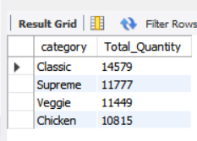
SQL
Project
6. JOIN THE NECESSARY TABLES TO FIND THE TOTAL QUANTITY OF EACH PIZZA CATEGORY ORDERED
QUERY :
RESULT :
SELECT
pizza_types.category,
COUNT(order_details.quantity) AS Total_Quantity
FROM
pizza_types
JOIN
pizzas ON pizzas.pizza_type_id = pizza_types.pizza_type_id
JOIN
order_details ON order_details.pizza_id = pizzas.pizza_id
GROUP BY pizza_types.category
ORDER BY Total_Quantity DESC;

Slide 9
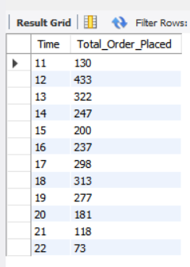
SQL
Project
7. DETERMINE THE DISTRIBUTION OF ORDERS BY HOUR OF THE DAY
QUERY :
RESULT :
SELECT
HOUR(orders.order_time) as Time,
COUNT(order_details.order_details_id) AS Total_Order_Placed
FROM
Orders
JOIN
order_details ON orders.order_id = order_details.order_id
GROUP BY Time;

Slide 10
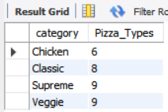
SQL
Project
8. JOIN RELEVANT TABLES TO FIND THE CATEGORY-WISE DISTRIBUTION OF PIZZAS
QUERY :
RESULT :
SELECT
category, COUNT(pizza_name) AS Pizza_Types
FROM
pizza_types
GROUP BY category;

Slide 11
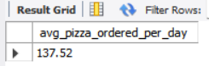
SQL
Project
9. GROUP THE ORDERS BY DATE AND CALCULATE THE AVERAGE NUMBER OF PIZZAS ORDERED PER DAY
QUERY :
RESULT :
SELECT
ROUND(AVG(quantity), 2) AS avg_pizza_ordered_per_day
FROM
(SELECT
orders.order_date, SUM(order_details.quantity) AS quantity
FROM
order_details
JOIN orders ON orders.order_id = order_details.order_id
GROUP BY orders.order_date) AS Total_Pizza_Quantity;

Slide 12
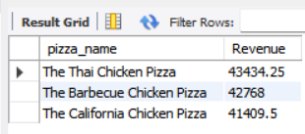
SQL
Project
10. DETERMINE THE TOP 3 MOST ORDERED PIZZA TYPES BASED ON REVENUE
QUERY :
RESULT :
SELECT
pizza_types.pizza_name,
SUM(pizzas.price * order_details.quantity) AS Revenue
FROM
pizza_types
JOIN
pizzas ON pizzas.pizza_type_id = pizza_types.pizza_type_id
JOIN
order_details ON order_details.pizza_id = pizzas.pizza_id
GROUP BY pizza_types.pizza_name
ORDER BY Revenue DESC
LIMIT 3;

Slide 13
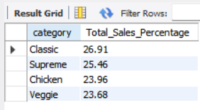
SQL
Project
11. CALCULATE THE PERCENTAGE CONTRIBUTION OF EACH PIZZA TYPE TO TOTAL REVENUE
QUERY :
RESULT :
SELECT
pizza_types.category,
ROUND(SUM(pizzas.price * order_details.quantity) / (SELECT
ROUND(SUM(pizzas.price * order_details.quantity),
2) AS Total_Sales
FROM
pizzas
JOIN
order_details ON order_details.pizza_id = pizzas.pizza_id) * 100,
2) AS Total_Sales_Percentage
FROM
pizzas
JOIN
order_details ON order_details.pizza_id = pizzas.pizza_id
JOIN
pizza_types ON pizzas.pizza_type_id = pizza_types.pizza_type_id
GROUP BY pizza_types.category
order by Total_Sales_Percentage desc;

Slide 14
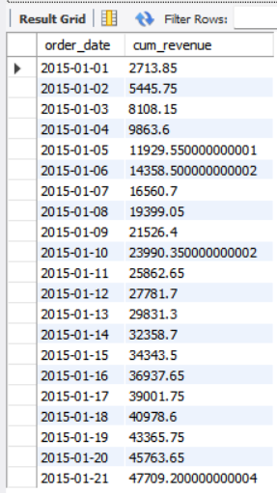
SQL
Project
12. ANALYZE THE CUMULATIVE REVENUE GENERATED OVER TIME
QUERY :
RESULT :
SELECT order_date, sum(Total_sales) OVER (order by order_date) AS cum_revenue
FROM
(SELECT orders.order_date, sum(order_details.quantity * pizzas.price) AS Total_sales
FROM orders
JOIN order_details ON orders.order_id = order_details.order_id
JOIN pizzas ON pizzas.pizza_id = order_details.pizza_id GROUP BY orders.order_date) AS sales;

Slide 15
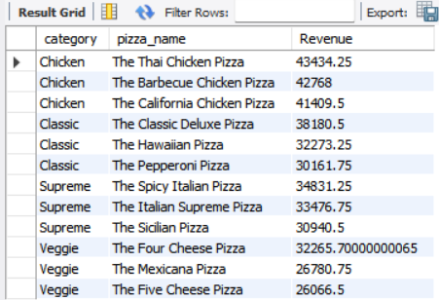
SQL
Project
13. DETERMINE THE TOP 3 MOST ORDERED PIZZA TYPES BASED ON REVENUE FOR EACH PIZZA CATEGORY
QUERY :
RESULT :
SELECT category, pizza_name , Revenue FROM
(SELECT category, pizza_name , Revenue,
RANK() over (PARTITION BY category ORDER BY Revenue DESC) AS rn
FROM
(SELECT pizza_types.category, pizza_types.pizza_name,
SUM(pizzas.price * order_details.quantity) AS Revenue
FROM
pizza_types
JOIN
pizzas ON pizzas.pizza_type_id = pizza_types.pizza_type_id
JOIN
order_details ON order_details.pizza_id = pizzas.pizza_id
GROUP BY pizza_types.category, pizza_types.pizza_name) AS a) AS b
WHERE rn <= 3;

Slide 16
SQL
Project
THANK YOU
FOR ATTENTION

